Slide 1

predictions for movie global revenue
METIS Winter 2021 DS Bootcamp
Project #2 –Carla Moestafa

Slide 2
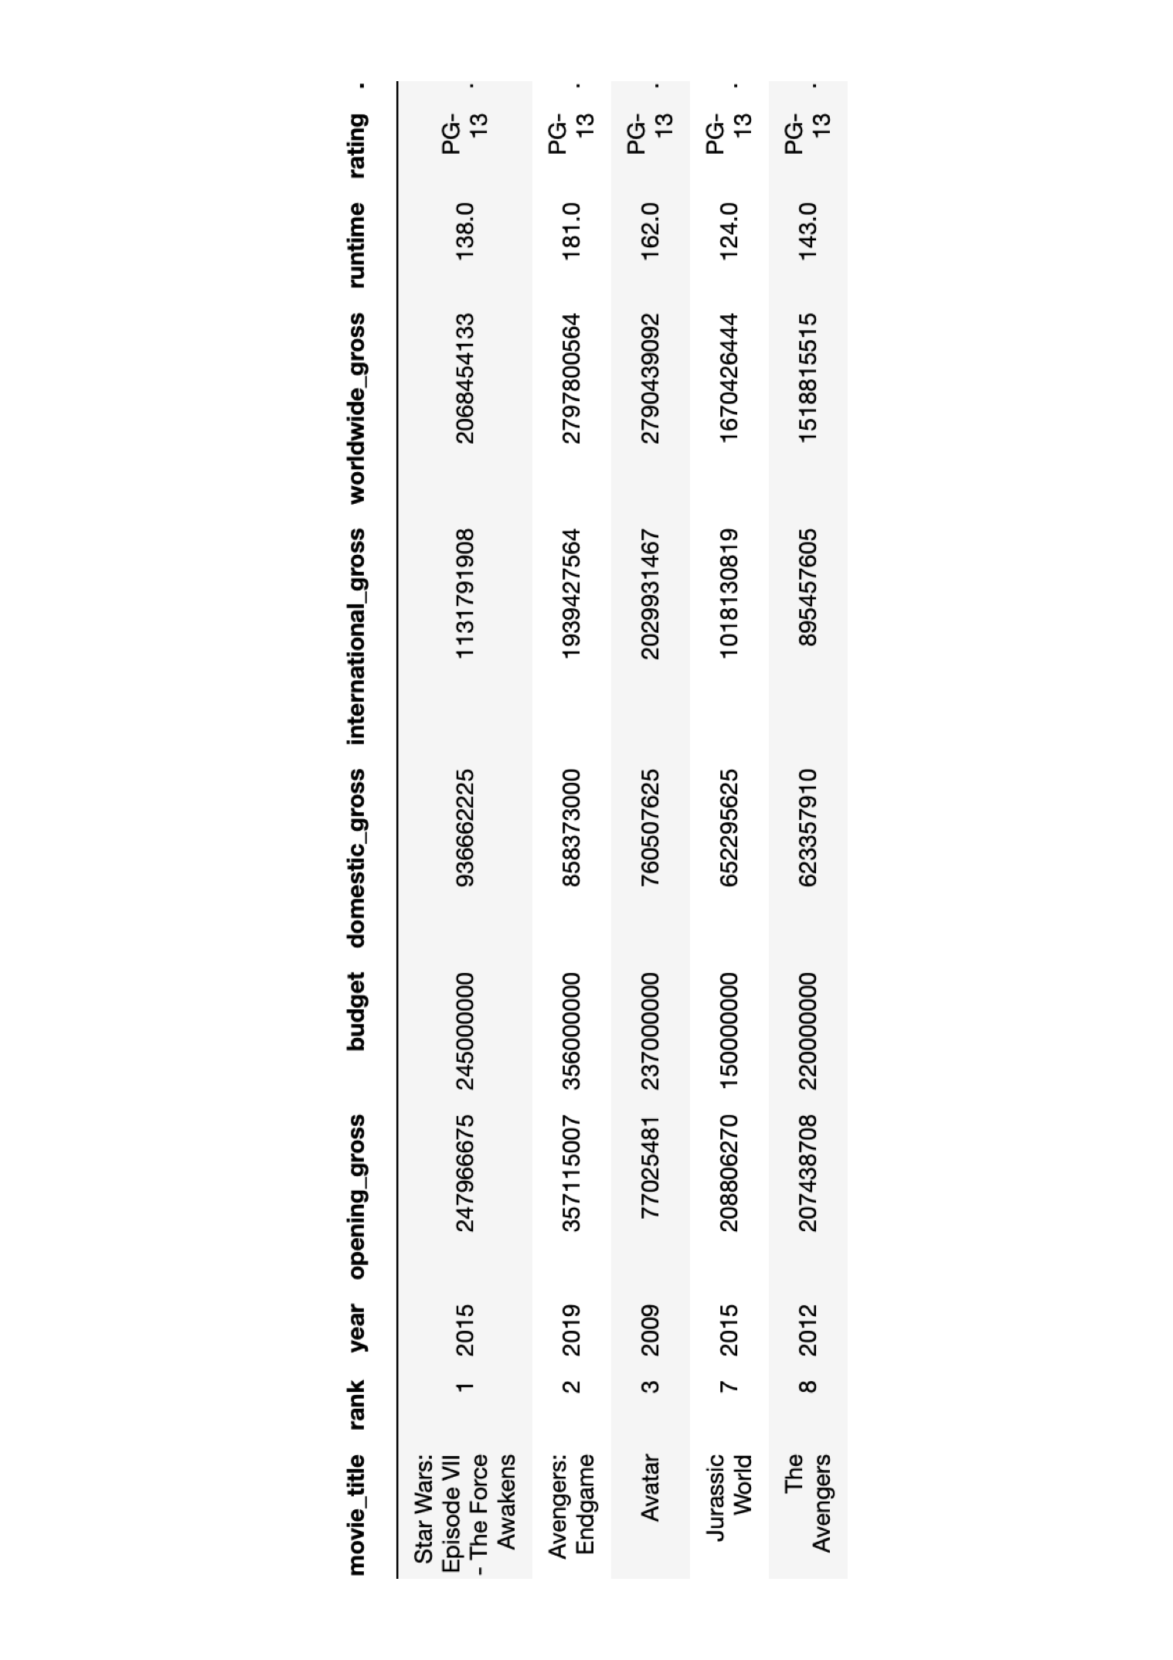
Data correlations

Slide 3
Predicting total global revenue upon domestic release
Objective
Build a predicting model to estimate the worldwide revenue at the domestic opening/release.
Motivation
If I were a significant stakeholder and I found myself in a situation where at the release of my movie that it generated less revenues that expected, I would want to be able to reassess and review my expectation of global revenues using a different model than the one that was used to sanction the movie production.

Slide 4

Predicting total global revenue upon domestic release
Motivation
Gross revenues generated domestically
107.5 B USD
Gross revenue generated worldwide
260.8 B USD
Information available
Release date
Main cast(s) and crew members
Distributor
Movie genres & rating
Distributor
Revenue from domestic opening
Production budget

Slide 5
Data used for my analysis
Movies from Y2000 onwards (Box Office Mojo)
Deleted rows without budget info
Deleted rows without runtime info
+/- 600 lines of data
Category | Data Range (Million USD)
Worldwide revenue | 86. 1 – 2,798
Budget | 0.015 - 356

Slide 6
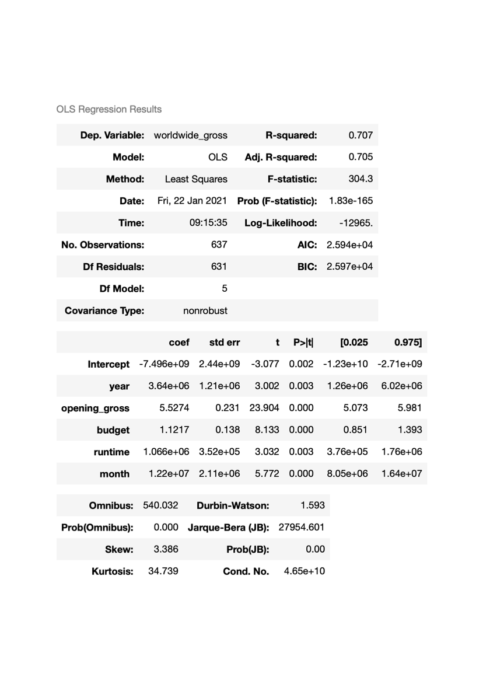
Initial assessment using statsmodel
OLS results from the initial dataset:
R^2 0.707
Notice the negative intercepts and very high condition numbers

Slide 7
Feature engineering
Feature engineering and preselection process
Started by dropping features with weakest correlation with the ’worldwide_gross’ and see the impact on R^2 values
Applying the 2nd degree Polynomial X**2
Applying 3rd degree PolynomialFeatures
Creating interaction features
Use highlevel ols scores without validation to preselect features for cross validation

Slide 8
Feature engineering
Conclusions from my selection process:
Keep all the features from the initial data.
Some X**2 and combination features were helpful to increase R^2
3rd degree PolynomialFeatures help to boost the the training R^2 but resulted in negative test R^2

Slide 9
Feature selection and cross validation
Each feature that increased the validation score is kept and a new candidate model is created to include that feature.
candidate models | features included | mean R^2 val scores
Initial Model | All simple features: opening_gross, budget, runtime, month, year | 0.737
Model 1 | Simple + opening gross **2 | 0.737
Model 2 | Simple + budget **2 | 0.715
Model 3 | Simple + runtime**2 | 0.741
Model 4 | Simple + runtime**2 + month**2 | 0.741
Model 5 | Simple + runtime**2 + year**2 | 0.741
Model 6 | Simple + runtime**2 + c1 (budget * runtime) | 0.741
Model 7 | Simple + runtime**2 + c2 (opening gross * runtime) | 0.730
Model 8 | Simple + runtime**2 + c3 (opening gross / year) | 0.743
Model 9 | Simple + runtime**2 + c4 (budget/year) | 0.744
Model 10 | Simple + runtime** 2 + c4 + c5 (month*runtime) | 0.745
Model 11 | Simple + runtime**2 + c4 + c5 + c6 (month*year) | 0.743
Model 12 | Simple + runtime**2 + c4 + c5 + c7 (month*opening gross) | 0.753
Model 13 | Simple + runtime**2 + c4 + c5 + c7 + PG + PG_13 + R | 0.760
Best candidate model

Slide 10
Final model selection with Lasso Regularization
Model 13 is the best model with mean R^2 validation score of 0.76 and test score of 0.511
Further investigation with Lasso Regularization:
CASE | REGULARIZED MODEL
CASE 1 | MODEL 13
CASE 2 | Model including simple and categorical features only
CASE 3* | MODEL 13 with opening revenues > 200 Million USD dropped
CASE 4* | CASE 3 with opening revenues < 0.5 Million USD removed
*Case 3 & 4 were carried out after and considering comments during presentation.

Slide 11
Final model selection using Lasso Regularization
CASE | R^2 TEST SCORE | MAE (Million USD)
CASE 1 | 0.523 | 118.7
CASE 2 | 0.502 | 116.0
CASE 3 | 0.714 | 96.9
CASE 4 | 0.638 | 105.0
The best predicting outcome is achieved by Case 3

Slide 12
Things I should have done better
Collecting and/or incorporating more data:
Actors/actresses
Director
Writers
Producer
Distributor
Genres
Inflation impacts?

